Slide 1
TABLEAU in a nutshell
Download materials: github.com/Winston722/Tableau

Slide 2

HELLO!
I am Winston Underwood
I’m a senior data analyst doing data science at Nationwide Insurance. I use R and Tableau at work, and I’m here to talk about Tableau.

Slide 3
1. Overview of Tableau 2. Demo 3. Questions

Slide 4
What is Tableau?
Powerful data visualization software
Industry standard
Drag-and-drop user friendly design

Slide 5
Why use Tableau?
Connects to almost any data source
Easy to learn / easy to use / easy to share
Interactive
Powerful and dynamic

Slide 6















Who uses Tableau?

Slide 7
Tableau’s Learning Curve
Table calculations, data blending, advanced graphs, etc
Level of detail calculations
Writing calculated fields, parameters
“Woah wtf is this drag and drop nonsense”

Slide 8
Tableau Guide
Let’s take a look at Tableau’s components

Slide 9
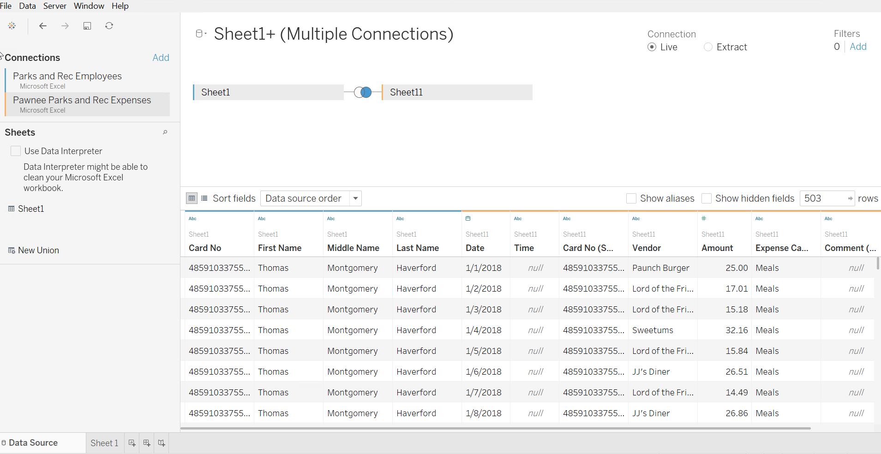

Slide 10
Add data sources here (Hadoop, Oracle, Excel, csv, txt, etc)

Slide 11
Add sheets / tables here

Slide 12
Configure table relationships

Slide 13
View data

Slide 14
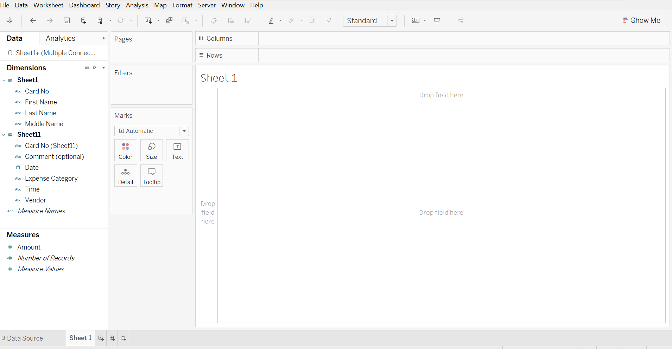
These are our discrete variables

Slide 15
These are our continuous variables

Slide 16
Drag variables to these locations to create charts

Slide 17
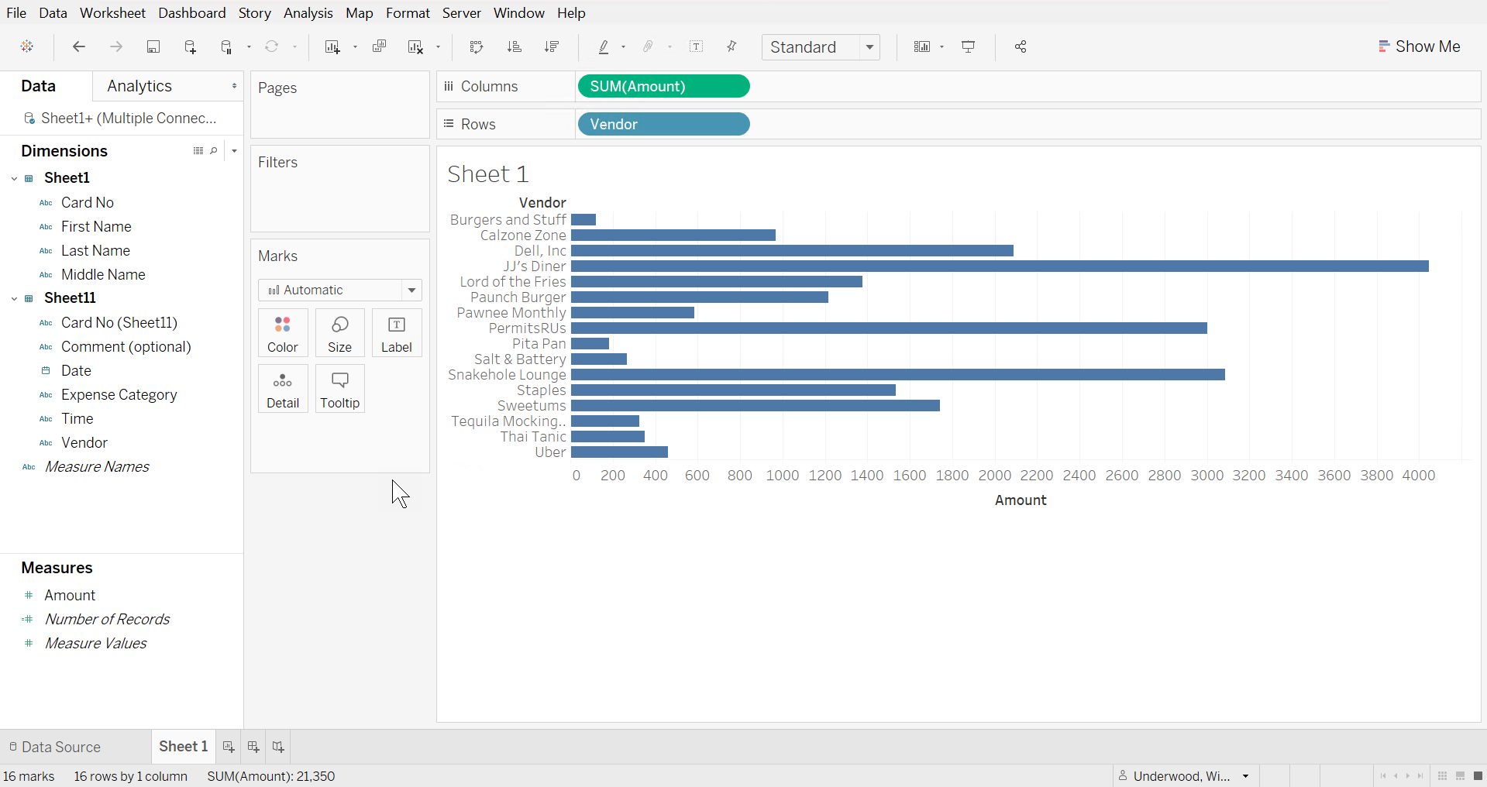

Slide 18
Tableau Structure
Each chart / graph is on a sheet
Each dashboard is made up of different sheets
Interacting one sheet can influence other sheets on that dashboard (e.g. adding a filter)
Tableau also has stories, which are a hybrid between dashboards and powerpoint

Slide 19
Our Data
Pawnee Parks and Rec Expenses
Column name | Description | Field Type
Trans No | Auto-generated transaction number | Character
Date | Auto generated date | Date
Card No | Full card number | Character
Vendor | Vendor name | Character
Amount | Purchase amount | Numeric
Expense Category | Manually entered category | Character
Comment | Necessary for >$100 | Character
Parks and Rec Employees
Column name | Description | Field Type
Card No | Full card number | Character
First name | Used first name | Character
Middle name | Used middle name | Character
Last name | Used last name | Character
1

Slide 20
Tableau Demo
Let’s jump into the software

Slide 21
Starting points
Beginner questions
What transactions stick out to you?
Does anything look fraudulent?
Transactions over $100 should always have a comment. What can we learn from comments?
Experienced questions
What does average transaction amount by vendor look like?
What’s the best way to visualize weekend transactions?
Make a spending dashboard for the Parks and Rec Department

Slide 22
More Tableau Resources
Need ideas? Try the Tableau Public Gallery
Getting started? Start with Tableau’s own training videos
Take your skills to the next level with Tableau Deep Dives

Slide 23
Thank You! Any Questions? Feel free to reach out!
Email me! Winston722@gmail.com
Connect! linkedin.com/in/winston722/

